Slide 1
VMCS with a New Perspective
PT04 – Object Oriented Design pattern
AMARJEET BRIJNANDAN SINGH - A0150157M
CHENG HAO - A0006467E
GONG SHENGLIANG - A0112429M
HU RENWEN - A0150352U
HUANG XIN -

Slide 2
Problem Description
Current design only accepts payment in the form of coins. Business object is tightly coupled with coin payment methodology.
System is not scalable enough to support alternative payment strategy like Debit/Credit Card payment without making substantial code change.
Ease of software extensibility is the primary concern.

Slide 3
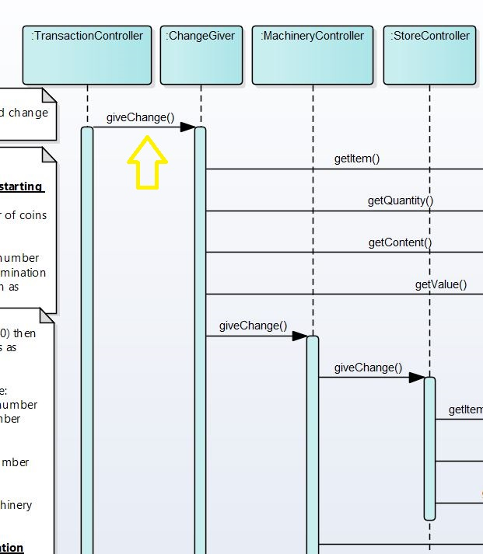
Sequence Diagram
Problem Description Continued…
Tight coupling between Transaction Controller and ChanngeGiver

Slide 4
Candidate Design Patterns
Factory Method
  The factory method pattern is a creational pattern used to defer object instantiation to subclasses
  Create concrete instances only. Different arguments may result in different objects. It depends on the logic etc.
  The purpose is to create an Object

Slide 5
Candidate Design Patterns
State
  Solution to the problem of how to make behavior depend on state
  Allow an object to alter its behavior when its internal state changes

Slide 6
Candidate Design Patterns
Strategy
  Defines family of algorithms, which will be interchangeable dynamically.
  Capture the abstraction in an interface, bury implementation details in derived classes.
  Supports open closed principle

Slide 7
Final Solution
Strategy design pattern
  Need to define different payment strategy and dynamically select one of them
  Promotes loose coupling between client and payment methodology
  Our problem is of behavioral type
  Scalable enough to support alternative payment method in future with minimal code change

Slide 8
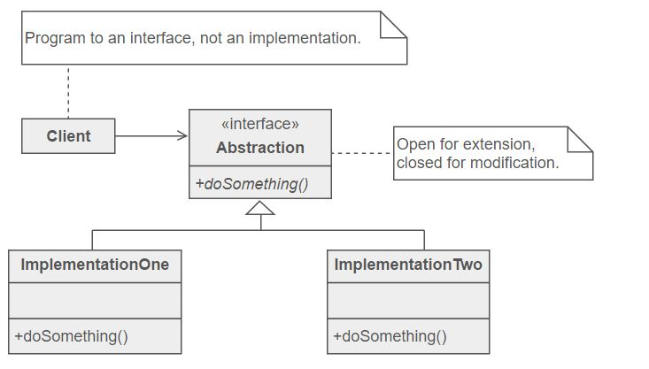
Strategy Design Pattern

Slide 9
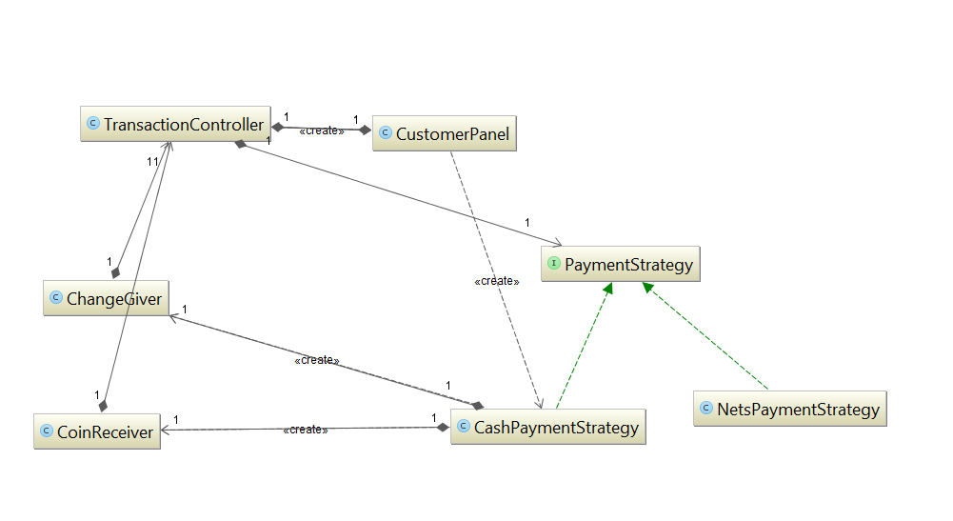
Strategy pattern class Diagram

Slide 10
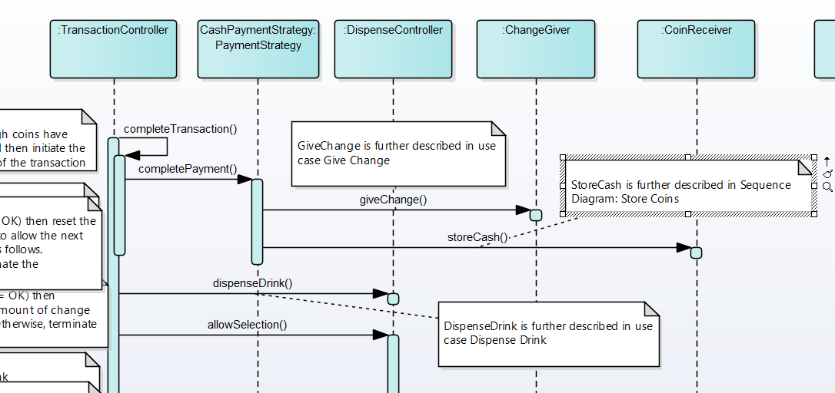
Complete Transaction
The diagram is from partial of the “Complete Transaction Use Case”.

Slide 11
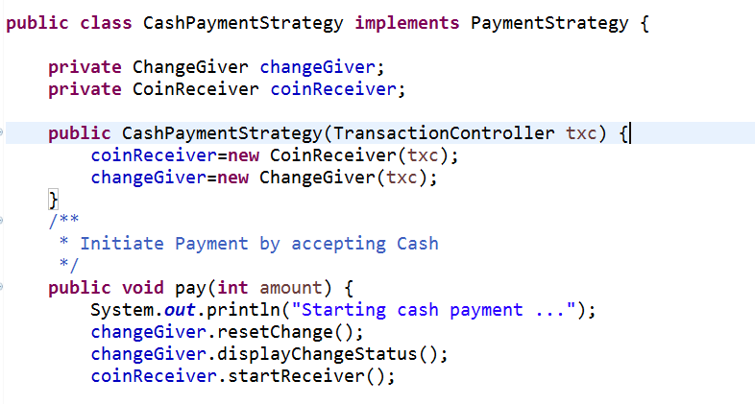
Code Snippet

Slide 12
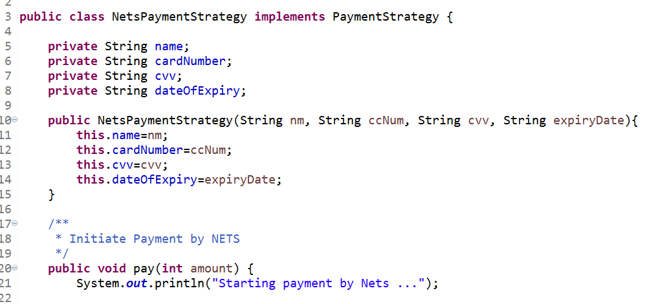
Code Snippet continued …

Slide 13

